Slide 1

DEFENCE SERVICES ACADEMY
M.Sc (21st Batch) Computer Science
DEPARTMENT OF COMPUTER SCIENCE
Pyin Oo Lwin
Notes:
Good Afternoon! Honorable and invited guests, all of my Lecturers, supervisor and my batch friends.

Slide 2
Cryptographic Protocols for Secure Voting Results In Election Voting System Using Fully Homomorphic Encryption (FHE)
Presented by
Captain Aung Myo Kyaw
M.Sc (21th Batch)
Supervisor Lt.Col Wunna Kyaw Kyaw
Co-supervisor- Lt.Col Saw Myint Soe Aung
2
Notes:
Firstly, May I introduce myself.
I'm Captain Zwe Wai Yan Phyo, and Master Candidate at Department of Computer Science.
Today I' would like to present my thesis work.
The title of my thesis is “Golf Score Management System with PHP Laravel Framework” .
And my supervisor is Major Ye Wint Mg Mg, and Co-supervisor is Maj Myo Min Hein.

Slide 3
Outlines
Abstract
Introduction
Aim of Thesis
Objectives of Thesis
Problem Statement
Background Theories
3
Notes:
OK! First of all, I would like to present outlines of my thesis.
In this seminar, I will present our thesis as these program. And generally divided by 7 state.
First stage is the abstract of our thesis.
Second stage is the Introduction of our thesis.
Third stage is the Aim of our thesis.
Fourth stage is the Objectives of our thesis.
Fifth is the Problem Statement .
Sixth is the Scope of thesis and background theory.
Finally, is the conclusion of our thesis.

Slide 4
Abstract
The integrity and security of election systems are fundamental to the democratic process, ensuring that the will of the people is accurately reflected in the results.
Fully Homomorphic encryption is a cryptographic method that allows computations to be performed directly on encrypted data, without requiring decryption at any stage.
We propose a cryptographic protocol based on Fully Homomorphic Encryption that enhances the security, privacy, and verifiability of electronic voting systems.
4
Notes:
In this slides, May I present about the abstract of my thesis.

Slide 5
Introduction
Elections are the cornerstone of democratic governance, serving as the primary mechanism through which citizens express their political will. The integrity, transparency, and security of election processes are paramount to ensuring that the outcomes accurately reflect the collective decisions of the electorate.
The central problem that thesis seeks to address is the inherent tension between maintaining voter privacy and ensuring transparency and verifiability in electronic voting systems.
5
Notes:
Now I would like to present the introduction of system.

Slide 6
Aim of my thesis
The aim of this thesis is to design, develop, and evaluate cryptographic protocols for secure election voting systems that leverage Fully Homomorphic Encryption (FHE) to ensure the confidentiality, integrity, and verifiability of the electoral process.
6
Notes:
Now I would like to present the introduction of system.

Slide 7
Objectives
To ensure the privacy of individual votes throughout the election process.
To build a system resilient to safeguard the integrity of elections.
To optimize the cryptographic protocol to make it efficient and feasible for deployment in real-world elections.
To design a system capable of handling large-scale elections efficiently.
7
Notes:
And then I would like to present the objectives of our thesis.

Slide 8
Problem Statement
The integrity of electoral processes is fundamental to the functioning of democratic societies.
Many existing electronic voting systems have vulnerabilities that can lead to various forms of electoral fraud, such as vote tampering, unauthorized access to voting data, and denial of service attacks, all of which can undermine the legitimacy of the election.
Fully Homomorphic Encryption (FHE) offers a promising solution by enabling computations to be performed on encrypted data, allowing for the secure aggregation of votes while keeping individual ballots confidential throughout the entire voting process.
8
Notes:
And then I would like to present the problem statement of system.

Slide 9
Background Theory
Electronic Voting System in Election
Cryptography
Fully Homomorphic Encryption (FHE)
Fully Homomorphic Encryption (FHE) in Voting
9
Notes:
In this slide, I would like to explore the history of web services, which were introduced in the late 1990s to facilitate communication between software applications over the internet.
Early web services used SOAP and XML for data exchange.
However, in the mid-2000s, the REST architectural style emerged as an alternative to SOAP-based web services. RESTful APIs offer a simpler and more lightweight approach to building APIs.
Today, web services play a critical role in enabling the integration of different software systems and applications.

Slide 10
Electronic Voting System in Election
An electoral system or voting system is a set of rules that determine how elections and referendums are conducted and how their results are determined.
Electoral systems are used in politics to elect governments, while non-political elections may take place in business, non-profit organizations and informal organizations.
These rules govern all aspects of the voting process: when elections occur, who is allowed to vote, who can stand as a candidate, how ballots are marked and cast, how the ballots are counted, how votes translate into the election outcome, limits on campaign spending, and other factors that can affect the result.
10
Notes:
In this slide, I would like to explore the history of web services, which were introduced in the late 1990s to facilitate communication between software applications over the internet.
Early web services used SOAP and XML for data exchange.
However, in the mid-2000s, the REST architectural style emerged as an alternative to SOAP-based web services. RESTful APIs offer a simpler and more lightweight approach to building APIs.
Today, web services play a critical role in enabling the integration of different software systems and applications.

Slide 11
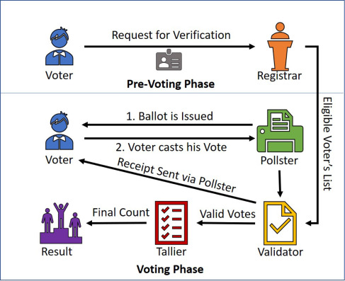
Architecture Electronic Voting System
11
Notes:
In this slide, I would like to explore the history of web services, which were introduced in the late 1990s to facilitate communication between software applications over the internet.
Early web services used SOAP and XML for data exchange.
However, in the mid-2000s, the REST architectural style emerged as an alternative to SOAP-based web services. RESTful APIs offer a simpler and more lightweight approach to building APIs.
Today, web services play a critical role in enabling the integration of different software systems and applications.

Slide 12
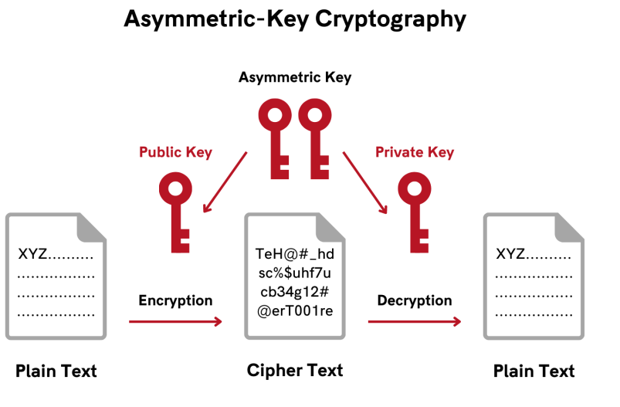
Cryptography
Cryptography is the practice of securing communication and data from unauthorized access, ensuring confidentiality, integrity, and authenticity of information.
It involves the use of mathematical algorithms to encrypt and decrypt messages, transforming readable data (plaintext) into an unreadable format (ciphertext) and vice versa.
14
Notes:
In this slide, I would like to explore the history of web services, which were introduced in the late 1990s to facilitate communication between software applications over the internet.
Early web services used SOAP and XML for data exchange.
However, in the mid-2000s, the REST architectural style emerged as an alternative to SOAP-based web services. RESTful APIs offer a simpler and more lightweight approach to building APIs.
Today, web services play a critical role in enabling the integration of different software systems and applications.

Slide 13
Fully Homomorphic Encryption (FHE)
Fully Homomorphic Encryption (FHE) is a groundbreaking cryptographic technique that allows computations to be performed directly on encrypted data without requiring decryption.
This means that data can remain confidential throughout its processing lifecycle, ensuring privacy while still enabling meaningful operations to be conducted.
The concept of homomorphic encryption was first introduced by Ronald Rivest, Leonard Adleman, and Michael Dertouzos in 1978, but it wasn't until 2009 that Craig Gentry proposed the first fully homomorphic encryption scheme.
15
Notes:
In this slide, I would like to explore the history of web services, which were introduced in the late 1990s to facilitate communication between software applications over the internet.
Early web services used SOAP and XML for data exchange.
However, in the mid-2000s, the REST architectural style emerged as an alternative to SOAP-based web services. RESTful APIs offer a simpler and more lightweight approach to building APIs.
Today, web services play a critical role in enabling the integration of different software systems and applications.

Slide 14
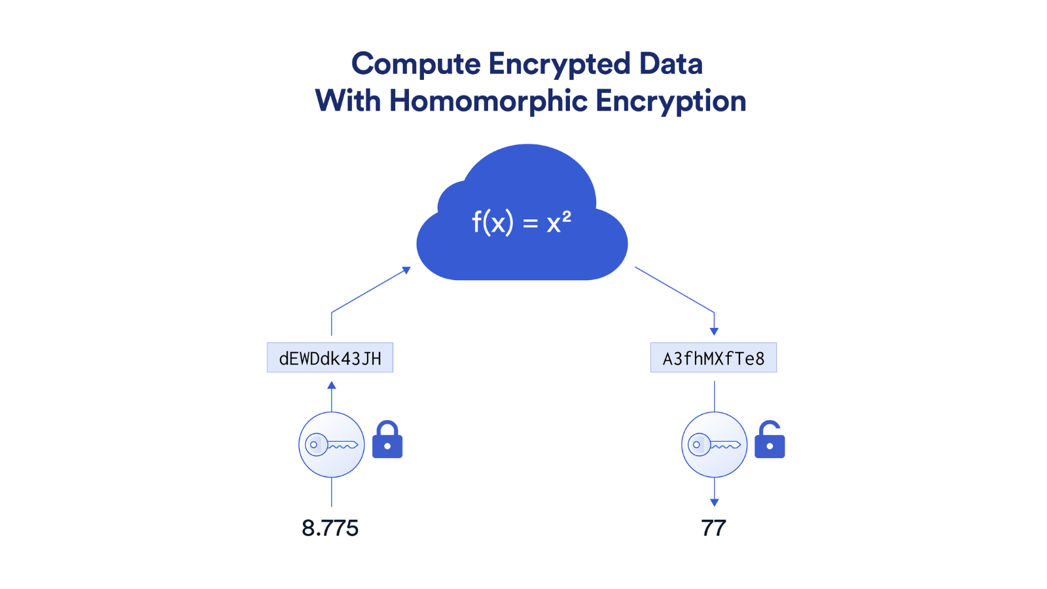
The Work Flow of FHE
16
Notes:
In this slide, I would like to explore the history of web services, which were introduced in the late 1990s to facilitate communication between software applications over the internet.
Early web services used SOAP and XML for data exchange.
However, in the mid-2000s, the REST architectural style emerged as an alternative to SOAP-based web services. RESTful APIs offer a simpler and more lightweight approach to building APIs.
Today, web services play a critical role in enabling the integration of different software systems and applications.

Slide 15
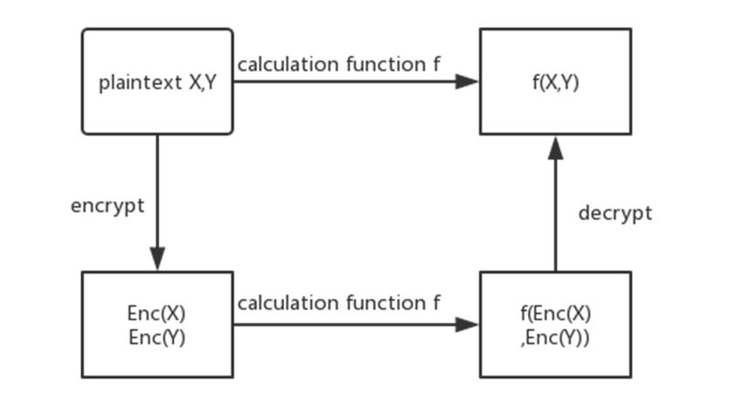
Fully Homomorphic Encryption (FHE) in Voting
First, it ensures end-to-end vote confidentiality, as all computations (such as addition of votes) are carried out on ciphertexts, preserving voter privacy throughout the process.
Second, it enables tamper-resistance, as encrypted votes cannot be altered without detection.
Third, HE supports verifiable computation, allowing stakeholders to verify the correctness of the result without exposing individual votes.
17
Notes:
In this slide, I would like to explore the history of web services, which were introduced in the late 1990s to facilitate communication between software applications over the internet.
Early web services used SOAP and XML for data exchange.
However, in the mid-2000s, the REST architectural style emerged as an alternative to SOAP-based web services. RESTful APIs offer a simpler and more lightweight approach to building APIs.
Today, web services play a critical role in enabling the integration of different software systems and applications.

Slide 16





Proposed System Design
Transfer)
Encrypt Ballot
Voter interface
( Website)
Vote a Ballot
Vote Result by Chart
Election Database
Decrypt Ballot
18

Slide 17
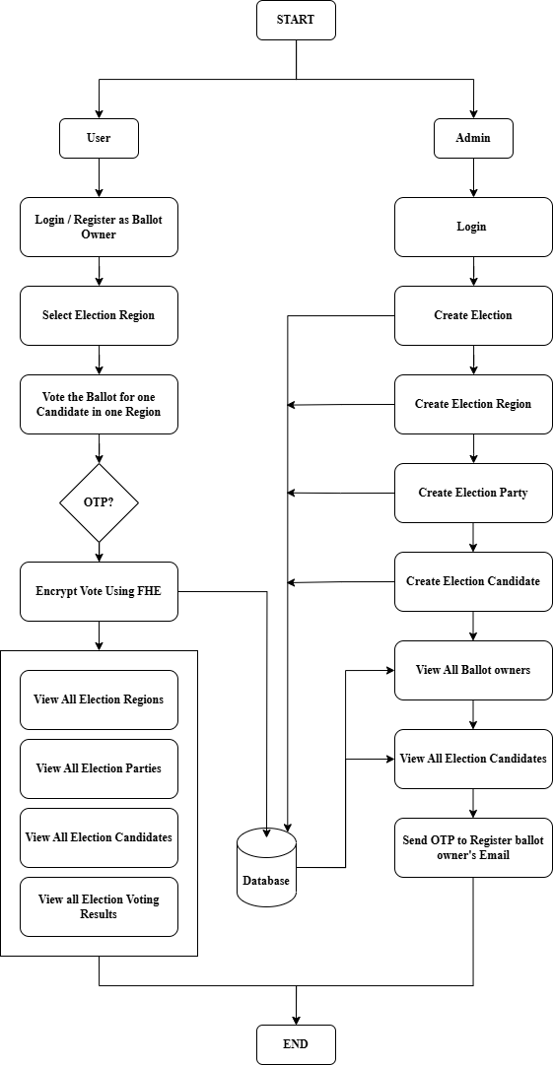
Overall System Design
Transfer)
19

Slide 18
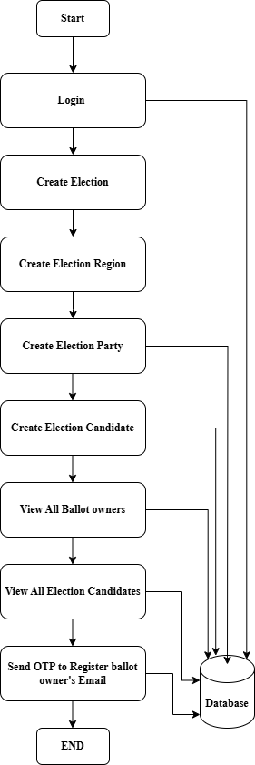
Detail Design For Admin
20

Slide 19
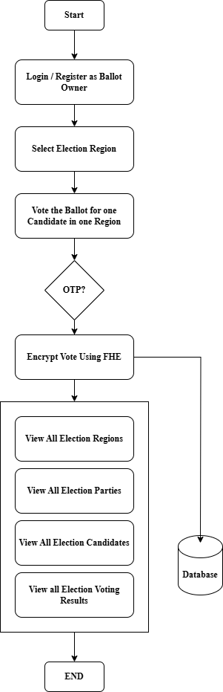
Detail Design For User
21

Slide 20
Conclusion
This thesis explored the design and implementation of a secure electronic voting system using Fully Homomorphic Encryption (FHE) to address the critical challenges of privacy, security, and transparency in modern election processes.
By leveraging FHE, the proposed system ensures that votes remain encrypted throughout the voting, storage, and computation phases, eliminating any risk of data breaches or unauthorized access.
The integration of cryptographic protocols, secure voter authentication through OTP verification, and transparent auditing mechanisms further strengthens the system's reliability and usability.
22

Slide 21
Thank You
Notes:
Thank you for your kind attention.

Slide 22
Please Comments & Suggestions.

